Slide 1


Tim Presland
May 2025

Slide 2

Outline
Executive Summary
Introduction
Methodology
Results
Conclusion
Appendix

Slide 3
Executive Summary
This Capstone project was carried out for "Space Y", using data science techniques to assess the success rates achieved by SpaceX. SpaceX uses its "Falcon 9" rocket, with the aim of successfully landing and recovering the stage 1 rocket component. This critical part of the mission determines whether costs associated with rocket launches can be significantly reduce, thus providing competitive advantage.
In this project, the following methodologies were used:
Data collection from the SpaceX APIs and web scraping from historical data relating to the Falcon 9 Wikipedia
Data wrangling, to assess and evaluate the datasets and attributes available, e.g. data relating to launch sites, orbits and mission outcomes
Exploratory Data Analysis (EDA), using data visualisations and SQL analysis
Create interactive visual analytics, using Folium maps to describe launch sites and Dashly dashboarding interactively allow analysis of success rates
Predictive analysis through building machine learning models, to assess the best models to use along with analysis of predictions of success outcomes
In summary, the key project findings were:
The most successful launch sites appeared to be CCAFS LC40 and KSC LC-39A, with success rates >70%
Payload appears to be a key factor in number of successful outcomes (the range 2000Kg to 7000Kg having most success)
The most successful rates were achieved using orbits HEO, GEO, ES-L1 and SSO
Success rates improved significantly between 2013 and 2017

Slide 4
Introduction
Project background and context
Rocket launches are potentially very expensive, with some organisations quoting over $160M to launch. SpaceX has innovated to allow recovery of the stage 1 rocket, reducing its costs to around $60M. This Capstone project was therefore carried out for "Space Y", using data science techniques to assess the success rates achieved by SpaceX and inform how Space Y can compete and provide competitive advantage.
Purpose of analysis
The aims of this data science project were to gather historical data for Space X launches in order to analyse the key features which determine and influence successful outcomes. Key findings sought were:
Relevance and geography of launch sites, using Folium maps
Relationships between key data attributes and outcomes, using visualisations, SQL analysis and dashboarding
Key features included payload, launch sites and orbits
Finally, use of machine learning models provided valuable feedback on how predictable, and using which key features, allowed the most successful predictive modelling

Slide 5

Section 1

Slide 6
Methodology
Executive Summary
Data collection methodology:
Python tools were used to extract SpaceX JSON data from its API services (api.spacexdata.com)
Additional historical data was derived using web scraping from the Falcon 9 Wiki pages
Perform data wrangling
Data was first cleaned to deal with missing data (e.g. payload mass mean value used)
Data was processed by creating DataFrames and filtering on key features e.g. 'payload', 'launch sites' etc.
Perform exploratory data analysis (EDA) using visualization and SQL
Perform interactive visual analytics using Folium and Plotly Dash
Perform predictive analysis using classification models
Resulting data was used to build ML models, using GridSearch to evaluate best parameters to use
Models used included Logistic Regression, SVC, Decision Trees and KNN

Slide 7
Data Collection
Data sets were collected from SpaceX's API services (api.spacexdata.com/v4) and web scraped from the Falcon 9 Wiki pages (https://en.wikipedia.org/wiki/List_of_Falcon_9_and_Falcon_Heavy_launches)
Following slides describe in more detail how each dataset was collected

Slide 8
Data Collection – SpaceX API
SpaceX REST calls process:
GitHub URL of the completed SpaceX API calls notebook:
https://github.com/timpresland/CapstoneProject/blob/main/jupyter-labs-spacex-data-collection-api-v2.ipynb
Initialise URL for the SpaceX past data
Get data as JSON and normalize, create corresponding DataFrame
Use requests.get to collect data for rockets, launchpads, payload and core data
Start data wrangling to create filtered datasets

Slide 9
Data Collection - Scraping
Web scraping process flowchart:
GitHub URL of the completed web scraping notebook:
https://github.com/timpresland/CapstoneProject/blob/main/jupyter-labs-webscraping.ipynb
Install and import BeautifulSoup library; initialise URL for Wiki page
Use requests.get(...) for data, create BeautifulSoup object (soup = BeautifulSoup (...))
Use find_all() method to iterate and find appropriate table, find "th" to get columns and build launch_dict
Create DataFrame from launch_dict and save to csv (df.to_csv())

Slide 10
Data Wrangling
Flowchart for data processing:
GitHub URL of data wrangling related notebooks:
https://github.com/timpresland/CapstoneProject/blob/main/labs-jupyter-spacex-Data%20wrangling-v2.ipynb
Filter data using DataFrame on [df['BoosterVersion' == 'Falcon 9']]
Assess for null values ( .isnull() )​
Replace missing payload mass values with mean (using .mean() and .fillna() methods)​
Save data to csv (using .to_csv() method)​

Slide 11
EDA with Data Visualization
The following charts were plotted. Scatter plots to analyse relationship between: - Payload Mass and Flight Numbers, using color to show Class (success / failure) - Launch Sites and Flight Numbers, using color to show Class (success / failure) - Payload Mass and Launch Sites, using color to show Class (success / failure) - Flight Numbers and Orbit, using color to show Class (success / failure) - Payload Mass and Orbit, using color to show Class (success / failure)
Line plot to show success rates over time, between 2010 and 2020
GitHub URL of completed EDA with data visualization notebook: https://github.com/timpresland/CapstoneProject/blob/main/jupyter-labs-eda-dataviz-v2.ipynb

Slide 12
EDA with SQL
SQL queries performed to show: - list of launch sites - 5 records where launch sites begin with the string 'CCA' - total payload mass carried by boosters launched by NASA (CRS) - average payload mass carried by booster version F9 v1.1 - date when the first succesful landing outcome in ground pad was achieved - names of the boosters which have success in drone ship and have payload mass greater than 4000 but less than 6000 - total number of successful and failure mission outcomes - booster_versions that have carried the maximum payload mass, using subquery - records which will display the month names, failure landing_outcomes in drone ship ,booster versions, launch_site for the months in year 2015 - rank the count of landing outcomes between the date 2010-06-04 and 2017-03-20, in descending order
GitHub URL of your completed EDA with SQL notebook: https://github.com/timpresland/CapstoneProject/blob/main/jupyter-labs-eda-sql-coursera_sqllite.ipynb

Slide 13
Build an Interactive Map with Folium
Map objects created and added to a folium map included: - circle object to create a reference location to NASA Johnson Space Centre - marker object (with icon showing text label), highlighting the location of the NASA Johnson Space Centre - child objects for each launch site, with circle and marker objects, as described above - marker clusters, to allow individual launch records to be drilled down (e.g. red = failure, green = success) - distance and polyline markers to highlight point to point distance to key references on the map (e.g. launch site to coast)
GitHub URL of the interactive map with Folium map: https://github.com/timpresland/CapstoneProject/blob/main/lab-jupyter-launch-site-location-v2.ipynb

Slide 14
Build a Dashboard with Plotly Dash
Plots / graphs and interactions added to the dashboard: - dropdown control to allow "ALL" or specific launch site filtering (comparison of success rates per launch site) - slider control to allow filtering of payload mass - pie charts to show % success of the selected filter (ALL sites or one specific launch site) - scatter plot to show success versus failure against selected site, payload, with color to show rocket booster version
GitHub URL of completed Plotly Dash lab: https://github.com/timpresland/CapstoneProject/blob/main/Capstone%20-%20Dash%20Project.ipynb

Slide 15
Predictive Analysis (Classification)
Install and import key libraries (scitkit-learn, seaborn); create function to displat confusion matrix (to be called later)
Methodology for build, evaluation, improvements and determining the best performing classification model shown in flowchart:
Add the GitHub URL of your completed predictive analysis lab, as an external reference and peer-review purpose: https://github.com/timpresland/CapstoneProject/blob/main/SpaceX-Machine-Learning-Prediction-Part-5-v1.ipynb
Previously created CSV with base data loaded; X (feature) values loaded and scaled using StandardScaler(); Y value array created for Class value
Training versus test data (20%) samples generated (train_test_split);
Models built for Logistic Regression, SVM, Decision Tree, KNN using process below
Parameter set defined
Model object initialised (as defined above)
GridSearch cbject created / model fitting
Best parameters and accuracy output
Predictive analysis run / accuracy vs test data measured
Confusion matrix output as appropriate

Slide 16
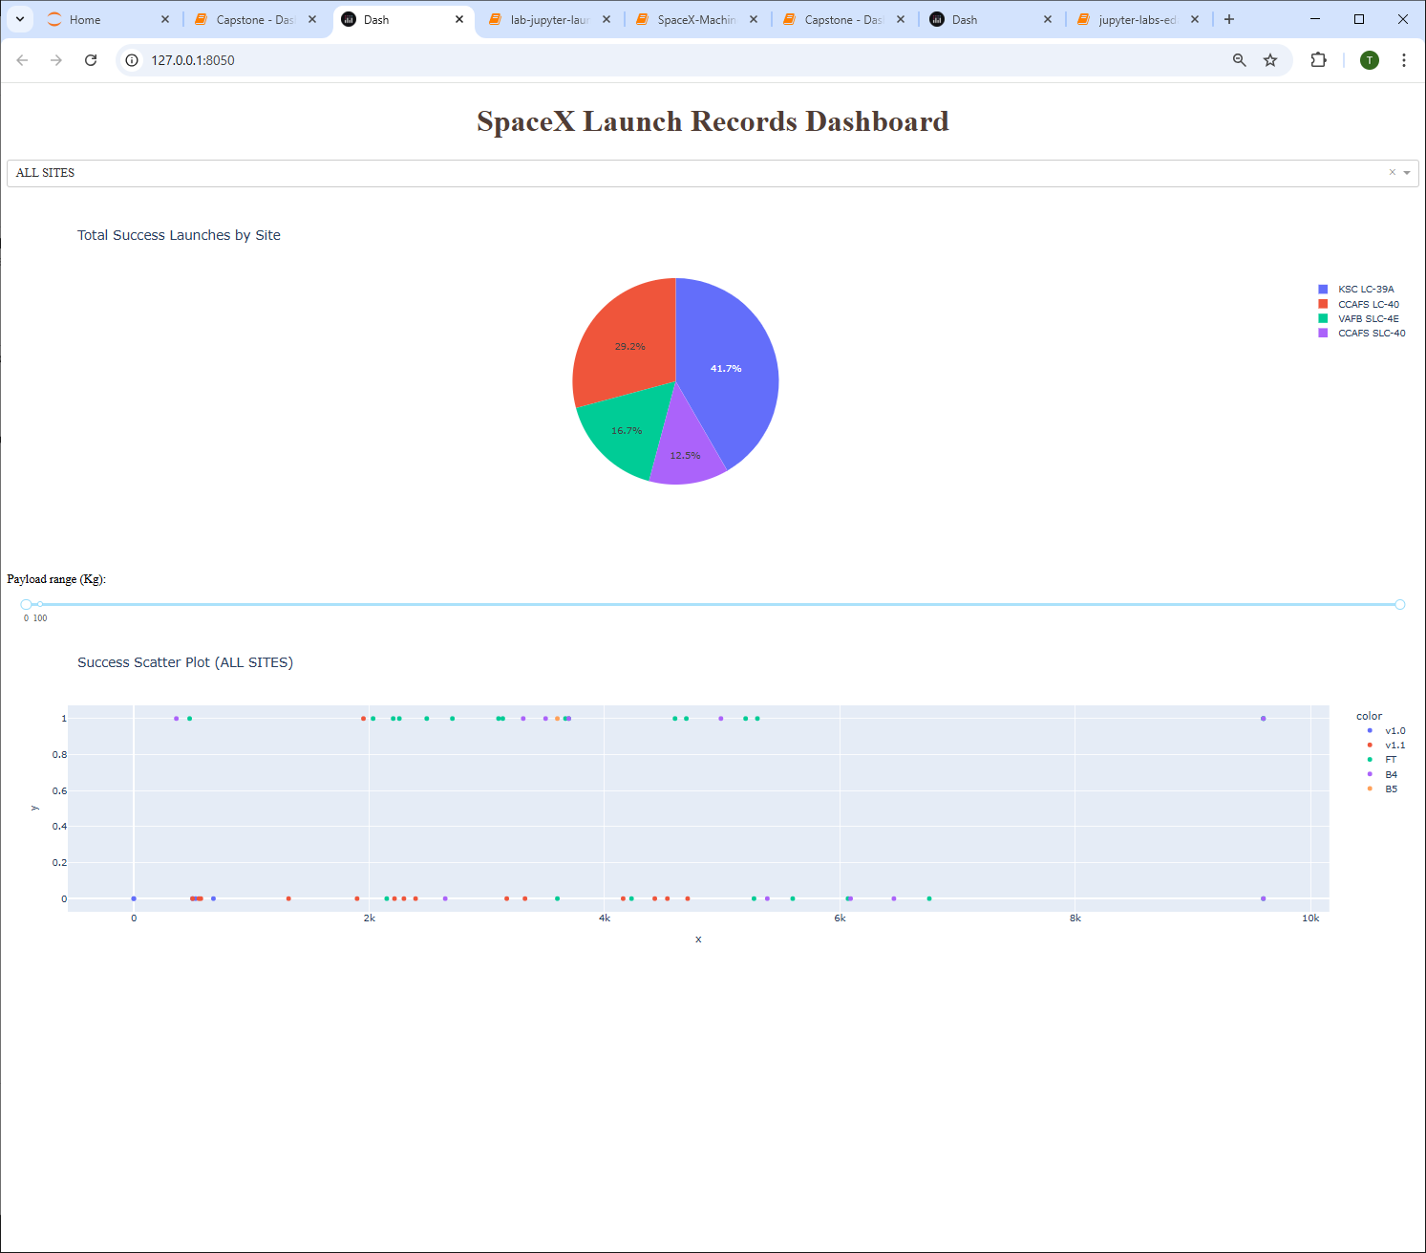
Results
Exploratory data analysis results: - total 90 records, 18 test samples - as flight number increased, success rate improved - payloads of 2000-7000Kg had more success - HEO, GEO, ES-L1, SSO orbits had the highest success rate - success rates increased from 2013-2017
Predictive analysis results: - accuracy scores for LR, KNN and SVC models very similar at around 85%, with test scores around 83% - Decision Tree best model with accuracy 87.5%, test score 94%

Slide 17

Section 2

Slide 18
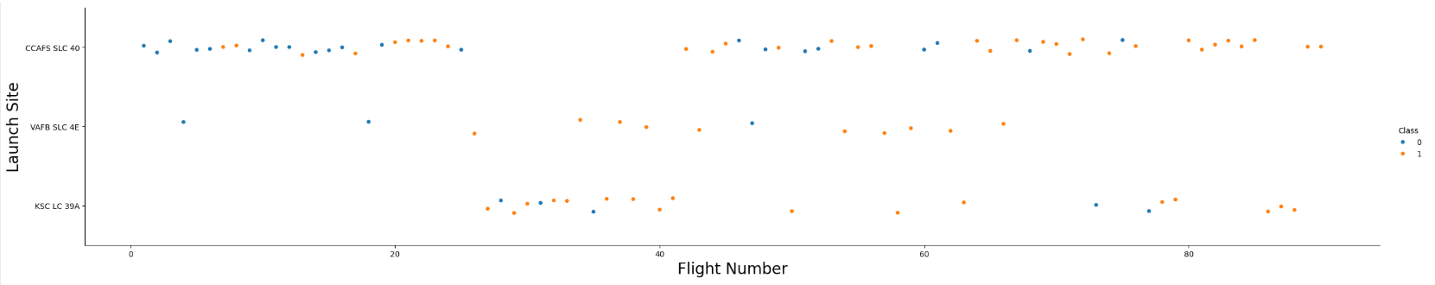
Flight Number vs. Launch Site
Scatter plot of Flight Number vs. Launch Site
CCAFS SLC40 shows most commonly used site, from earliest to latest flight numbers
All sites show an improving success rate with time

Slide 19
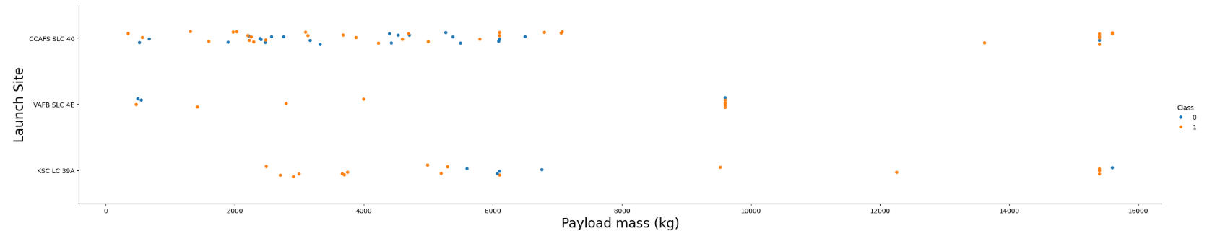
Payload vs. Launch Site
Scatter plot of Payload vs. Launch Site
Most successful missions are with payload mass between 2000 and 6000 Kg
Success rates good with larger payloads but fewer occurences

Slide 20
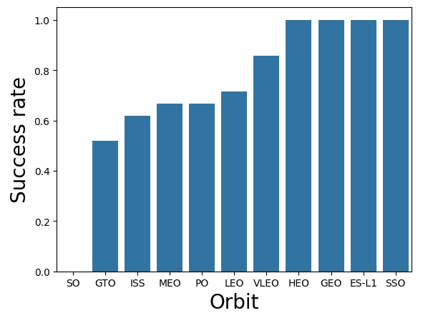
Success Rate vs. Orbit Type
Bar chart for the success rate of each orbit type
HEO, GEO, ES-L1 and SSO 100% success rate
SO and GTO orbits had poorest success rate

Slide 21
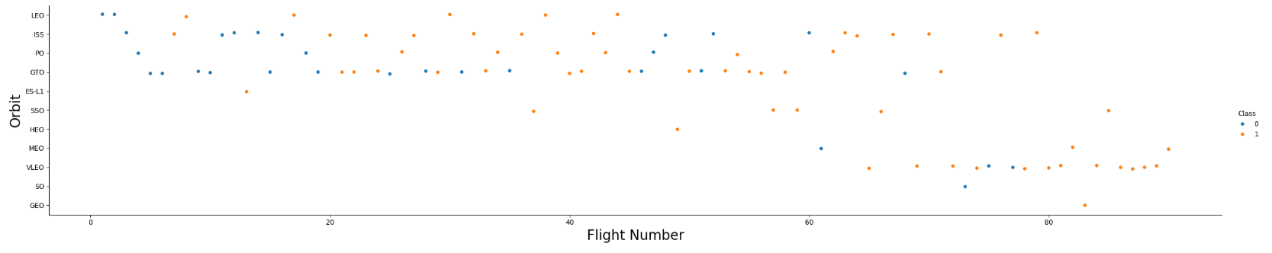
Flight Number vs. Orbit Type
Scatter point of Flight number vs. Orbit type
Latest flights were very successful, particularly using the VLEO orbit
Earliest flights showed poor success rates

Slide 22
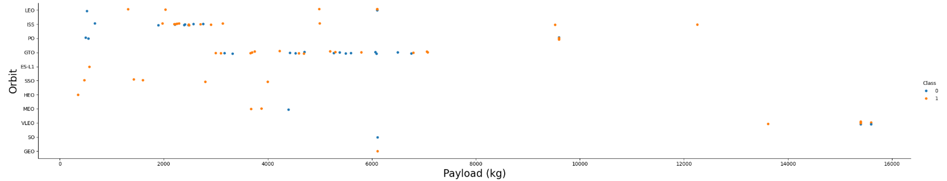
Payload vs. Orbit Type
Scatter point of payload vs. orbit type
Most successes with payload between 2000 and 6000 Kg
High failure rates evident on the ISS and GTO orbits, with little correlation against payload size

Slide 23
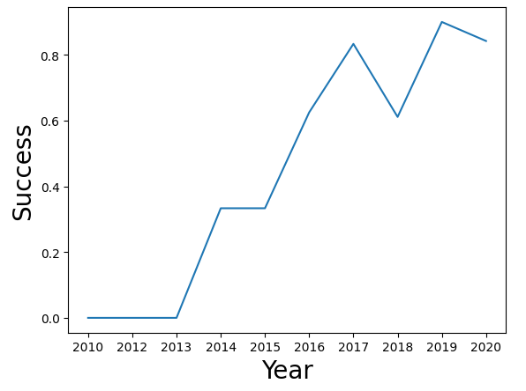
Launch Success Yearly Trend
Line chart of yearly average success rate
Poor success rates between 2011 and 2013
Rapidly increasing success rates from 2013 to 2017
Success rates appear to be plateauing after 2017

Slide 24
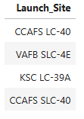
All Launch Site Names
Unique launch sites: CCAFS LC-40, VAFB SLC-4E, KSC LC-39A, CCAFS SLC-40
Distinct select query using "Launch_Site" column used to provide unique list of sites

Slide 25
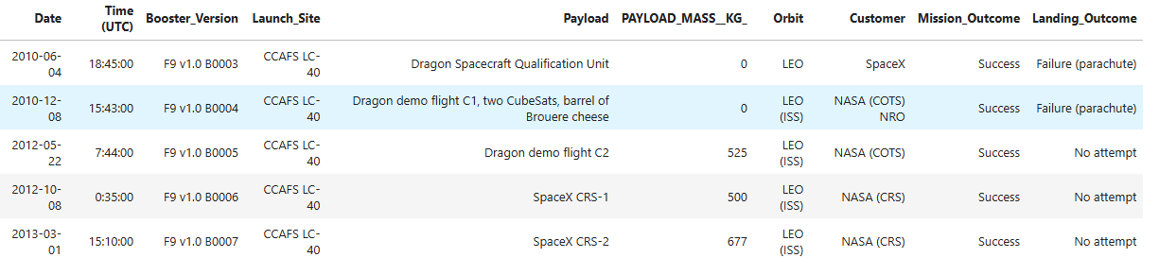
Launch Site Names Begin with 'CCA'
5 records where launch sites begin with `CCA`
Select query used with the "LIKE" operator to find site names ("Launch_Site" column) prefixed with "CCA"

Slide 26
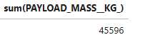
Total Payload Mass
Total payload carried by boosters from NASA = 45,596Kg
"sum" operator used in select query on "PAYLOAD_MASS_KG" column, where clause to filter on NASA site only

Slide 27
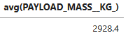
Average Payload Mass by F9 v1.1
Average payload mass carried by booster version F9 v1.1 = 2928.4Kg
"avg" operator used in query, filtered on column "Booster_Version" where equal to "F9 v1.1"

Slide 28
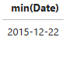
First Successful Ground Landing Date
Dates of the first successful landing outcome on ground pad = 22 December 2015
"min" operator used on "Landing_Outcome" column; "LIKE" clause used to filter on "%Success (ground pad)%" criteria

Slide 29
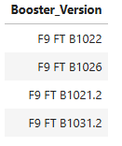
Successful Drone Ship Landing with Payload between 4000 and 6000
Names of boosters which have successfully landed on drone ship and had payload mass greater than 4000 but less than 6000 (F9 FT B1022, F9 FT B1026, F9 FT B1021.2, F9 FT B1031.2)
Greater and less than operators used (<, >) to filter result using "PAYLOAD_MASS_KG" column
"Landing_Outcome" column filtered using LIKE criteria for "%Success (drone ship)%"

Slide 30
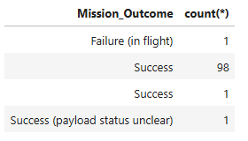
Total Number of Successful and Failure Mission Outcomes
Total number of successful (100) and failure (1) mission outcomes
Distinct "Mission_Outcome" values used to group sum of records for each

Slide 31
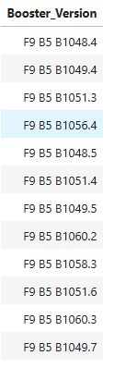
Boosters Carried Maximum Payload
Names of the booster which have carried the maximum payload mass = see below right!
"max" operator used to create subquery to find maximum payload value
Max value used as filter in select query to find all booster versions corresponding to thay payload mass

Slide 32
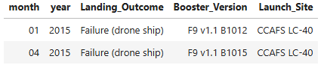
2015 Launch Records
Failed landing_outcomes in drone ship, their booster versions, and launch site names for in year 2015
Select query used with criteria for year (2015) and "LIKE" clause to isolate failure on drone ships
Substring functions used to separate date into month and year values

Slide 33
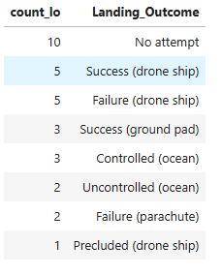
Rank Landing Outcomes Between 2010-06-04 and 2017-03-20
Rankings for the count of landing outcomes (such as Failure (drone ship) or Success (ground pad)) between the date 2010-06-04 and 2017-03-20, in descending order
Counts of "Landing_Outcome" column values used to group each type
Date filtered using "between" operator
Descending operator ("DESC") used to rank highest to lowest

Slide 34

Section 3

Slide 35
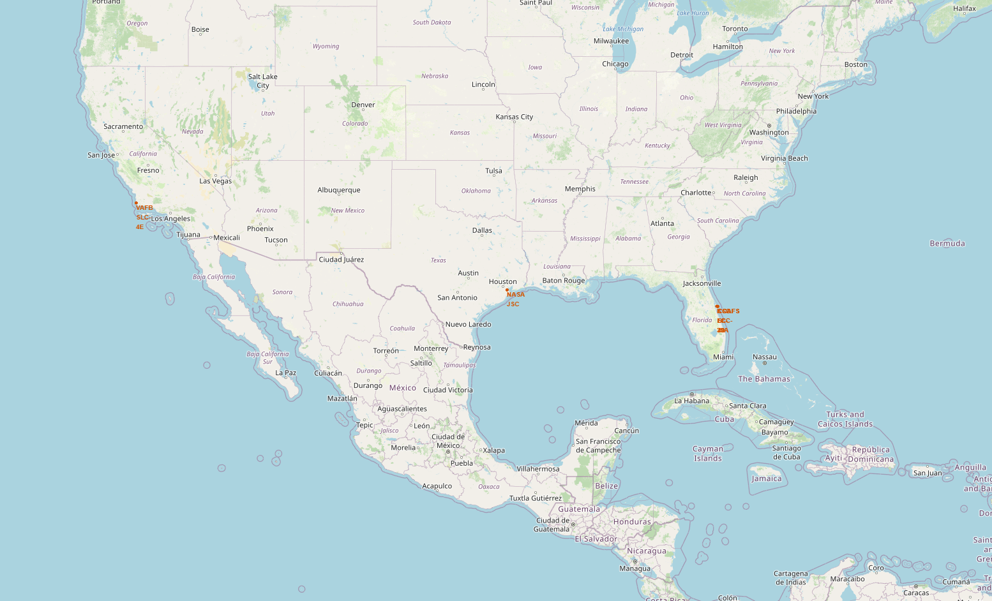
Folium Map Screenshot – Launch Site Locations
Key findings: - launch sites tend to be on the coast - sites are not in city areas - sites are close to key infrastructure, such as roads, railways and airports

Slide 36
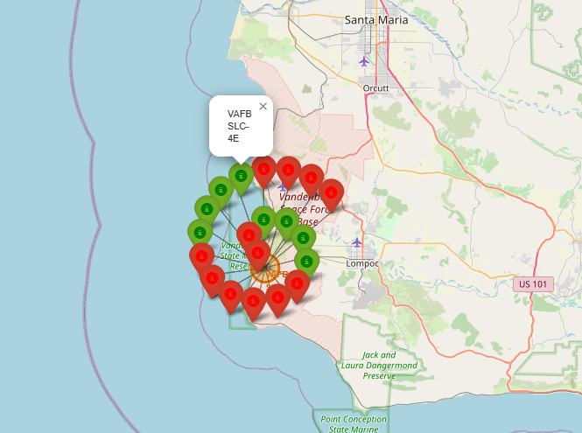
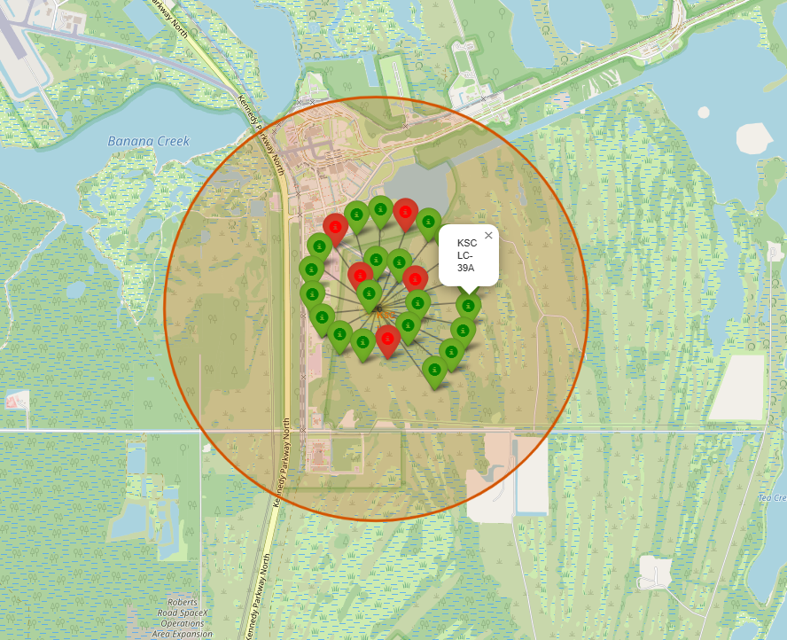
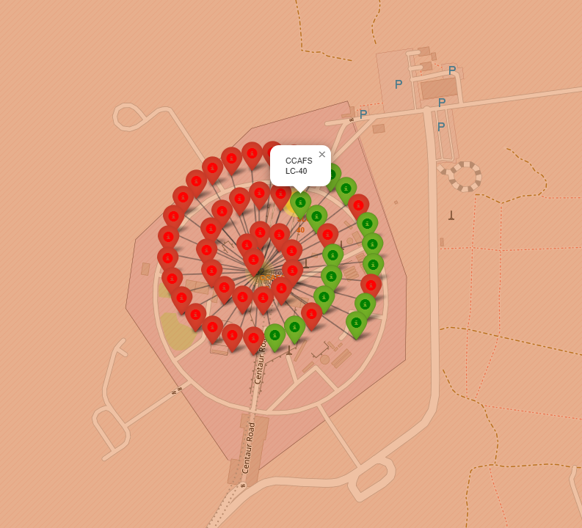
Folium Map Screenshot – Launch Outcomes
Key findings: - CCAFS LC-40 site has lower success rate than other sites - VAFB site has mixed performance - KSC LC-39A clearly has better success rate

Slide 37
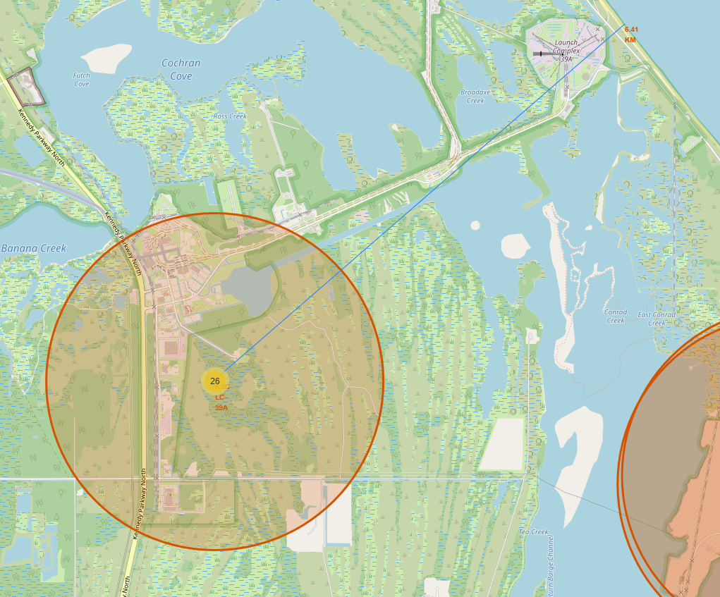
Folium Map Screenshot – Coastal Proximity
Key findings: - launch site only 6.4Km from coast - close to key infrastructure, such as highway and railway

Slide 38

Section 4

Slide 39
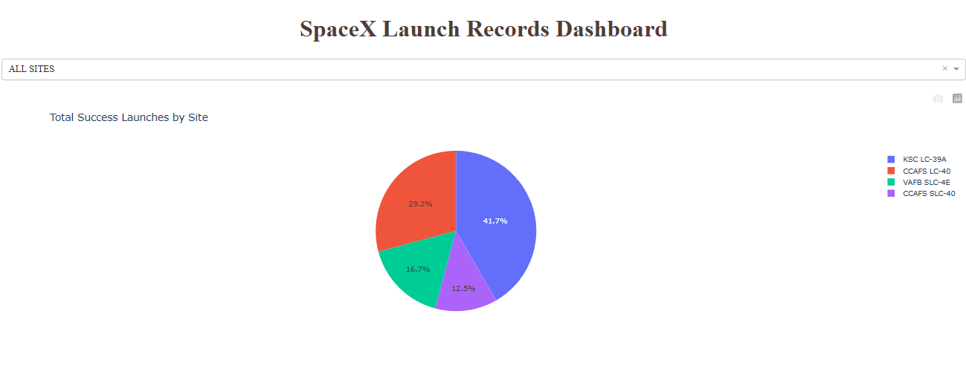
Dashboard Screenshot – Launch Success (All Sites)
Key observations: - KSC LC-39A has the highest success rate (41.7% of all successful launches took place there) - VAFB SLC-4E and CCAFS SLC-40 poorest (<20%)

Slide 40
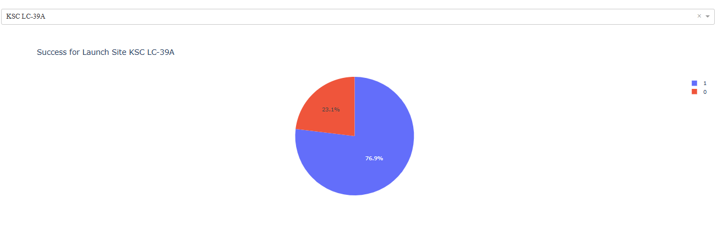
Dashboard Screenshot – Most Successful Launch Site
Key observations: - KSC LC-39A has a high success rates (~77% of its launches succeeded)

Slide 41
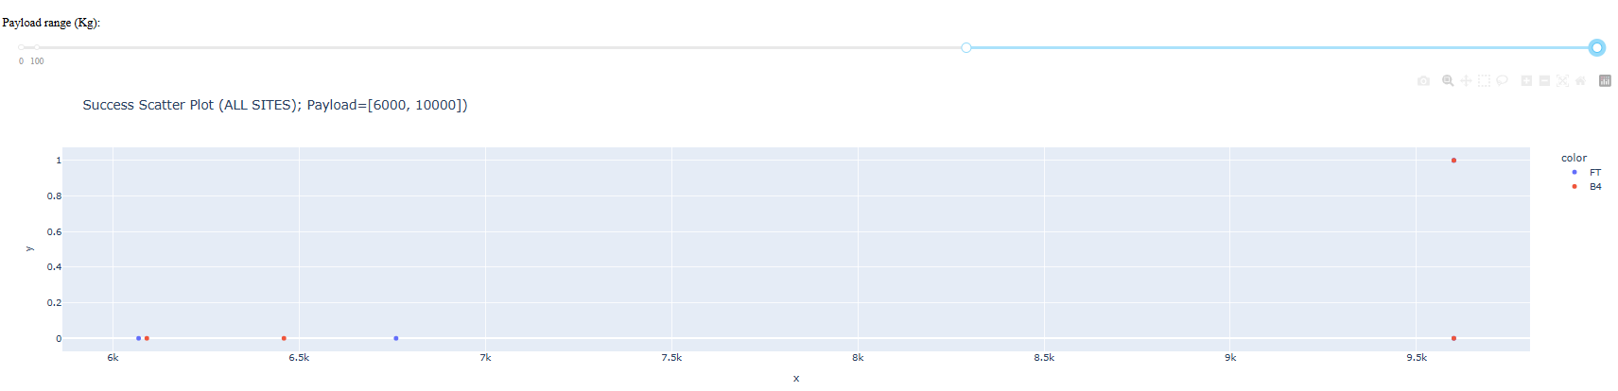
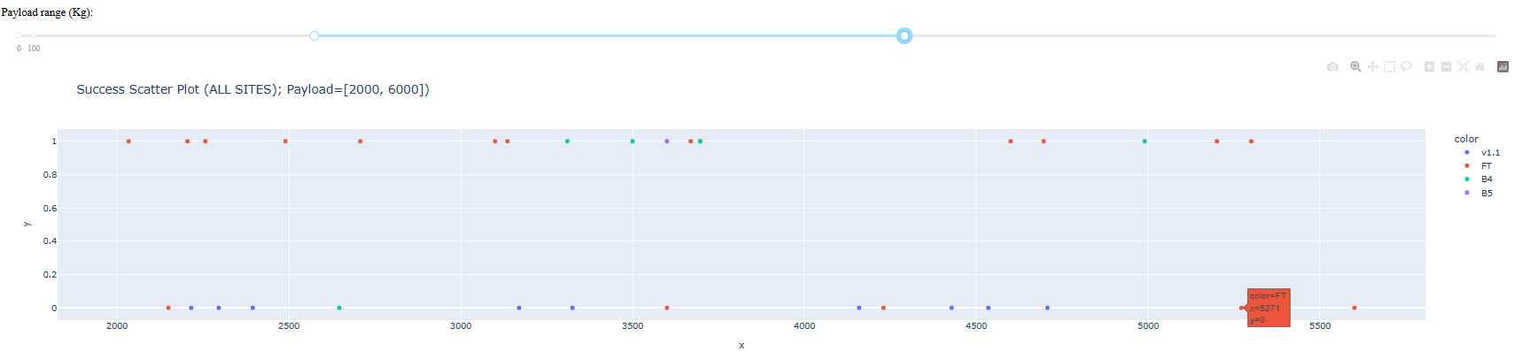
Dashboard Screenshot – Payload Ranges (All Sites)
Top scatter shows that higher payload ranges have poor success rates
Bottom scatter shows much better success rate at lower payload range (in this case 2,000 to 6,000 Kg)

Slide 42

Section 5

Slide 43
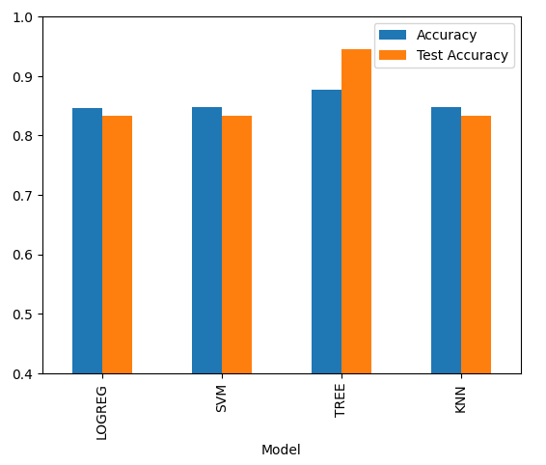
Classification Accuracy
Visualisations using bar chart to show model accuracies:
Decision Tree has the best accuracy with >90% on test data
LogReg, SVM and KNN all similar with accuracy around 85%

Slide 44
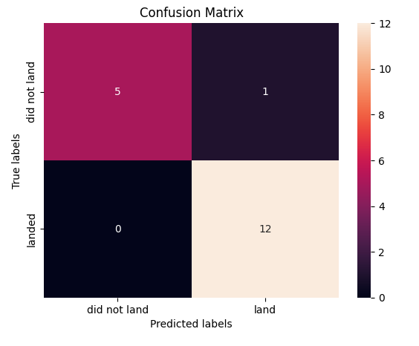
Confusion Matrix
Confusion matrix of best performing model
Results in 12 true positives, 5 true negatives, zero false negatives and only1 false positive

Slide 45
Conclusions
Decision Tree classification proved to be the most successful model
The tree also performed better than expected against the test data
The logistic regression, SVM and KNN models were all moderately good and similar in results, but not as good as the decision tree

Slide 46
Appendix
URL to full GitHub repository: https://github.com/timpresland/CapstoneProject

Slide 47


